Slide 1
House Prices and regression techniques
An Approach towards analytics and prediction
By
Koneru Geetika

Slide 2
Topics:
Problem Definition
Work flow stages employed
Distribution of features
Data cleaning and its insights
Wrangling, aggregation and its insights
Model , predict and solve
Solution analysis and conclusion

Slide 3
Problem Definition:
Ask a home buyer to describe their dream house !!
They would typically talk about the number of rooms, kitchen or to an extent might talk about the garage spaces to fit in the number of cars that they would need.
Features like basement, ceiling, proximity to the rail road are far less discussed.
Many features more than the one discussed above influence the price negotiation.
Here we have a training and test data set with as many as 74 features to be modelled to predict the sales prices of the test dataset.

Slide 4
Workflow stages employed:
Data Exploration: Explore the data in the training dataset.
Distribution of Features: Categorize features and its importance.
Data Cleaning: Identify and mitigate the null values, handling NaN, fill the empty columns, Cumulative mean, String correction, identify and drop not much useful features.
Data Wrangling and Aggregation: Wrangle data features based on Amenities, Neighborhood, Lot area, Basement, Roof style, Building data, Garage Details, House Area, Sale details.
Plotting: 3-Dimensional analysis, Year and sale analysis, Conditional and quality analysis.
Machine learning model implementation and sale price prediction.

Slide 5

Distribution of features: Training
Records and features (1467,81)
df.info() – float64(5),int64(33), object(43)
20 features that has missing values
Sale Price 1452/1467 are non null values
Mean Sale Price: $1.81L, while max at $75L and calculation at quartiles.
15 Sales price values with NaN,261 Lot Frontage values with 0.0, 5 records with Sale Condition as error.
PoolQc with 1450 NA values.
GarageQual – TA
LowQualFinSF,BsmtHalfBath has all zero values.

Slide 6

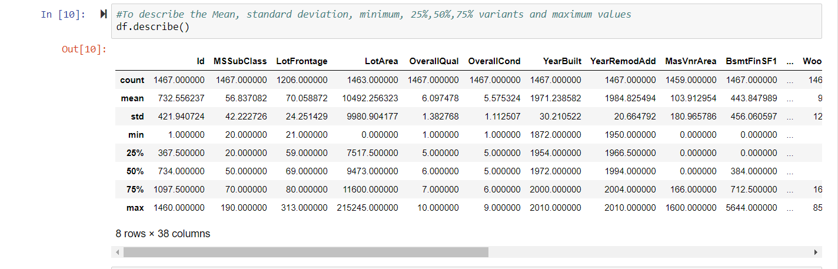


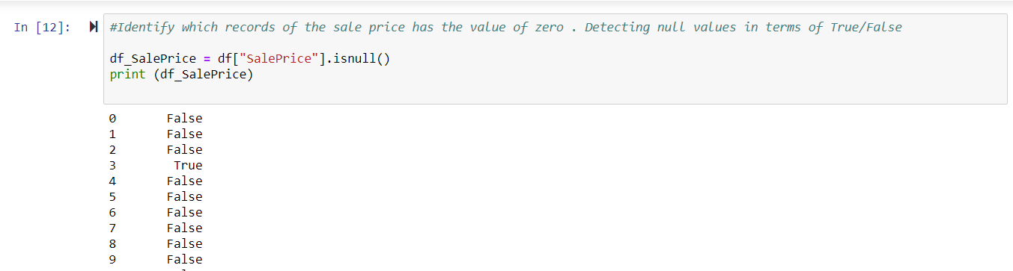
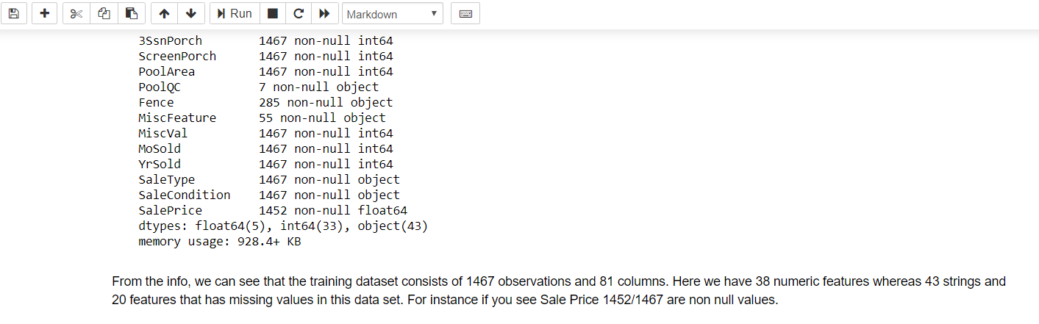

Distribution of features: Training

Slide 7
Data Cleaning and its insights:
Sales Price has 15 ‘NaN’ values. Computed cumulative mean.
Lot Frontage, Fence and MiscFeatures ‘NaN’ has been replaced with 0.
Dropped Columns:
All the houses have the air condition and Heating systems.
LowQualFinSF,BsmtHalfBath - zero values.
KitchenAbvGr - all values as 1.
GarageQual, GarageCond – all values as TA
PavedDrive as Y
3SsnPorch, ScreenPorch, PoolArea, PoolQC has nothing to do since most of the values are either 0 or null.
Identify and drop duplicates.
The cleaning goal is to keep the data integrity.
The data is now with 1467 entries and 71 columns.

Slide 8
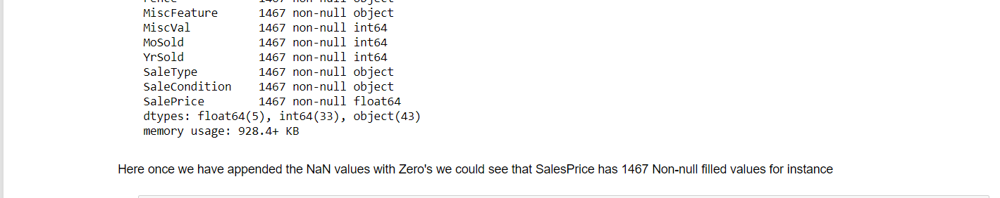
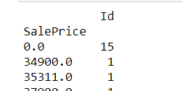
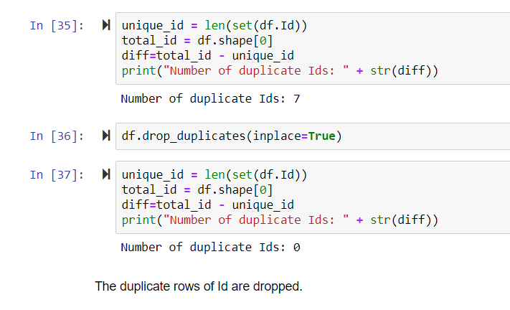
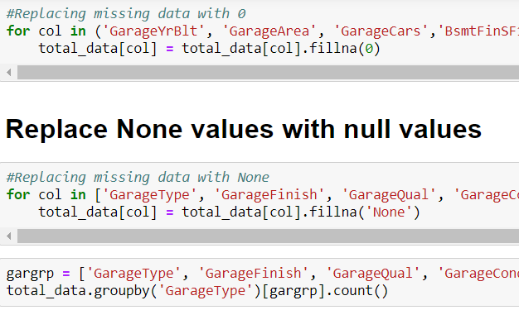
Data Cleaning and its insights:

Slide 9
Wrangling, Aggregation and its insights:
Data frames formed for Amenities, Neighborhood, Lot Description, Basement, Roof Style, Building details, Garage Details, House area, Sale details, Building details, Basement details.
With respect to max()and min() of Sales Price:
Regrouped the data based on year sold and Sale type, Year Built and year renovated, House style.
Regrouped the data based on garage type and garage area.

Slide 10

Wrangling, Aggregation and its insights:
Garage Date Frame:
Highest – TotRmsAbvGrd: (4,AllPub); Fireplaces:(7,AllPub)
Wood Deck houses has maximum price compared to openPorchSF in 2000 and 2010.
Basement details:
The relation between BsmtUnfSF & TotalBsmtSF : (13,Gd) are equal.
Building Type:
(4,1Fam) The condition of houses with condition of 4 & Single family detached has the highest price when renovated.
House Area:
Condition of 11 with garage living area > 840 has highest price.
The more the basement area, the more is the area of the first floor.
2007, WD – warranty deed conventional has the highest sale price.
Pair plots: 4 variety of pair plots and box plots to get the relative insights of these data frames.

Slide 11
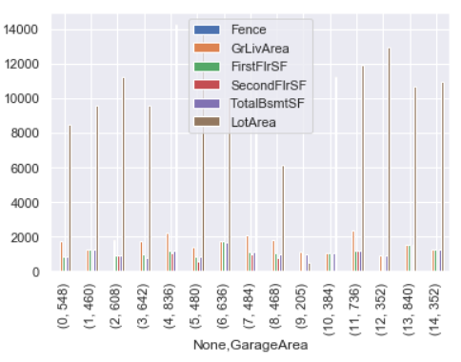
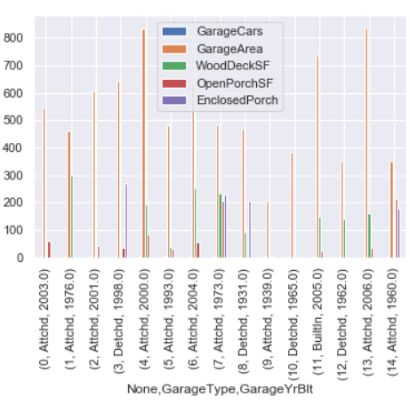
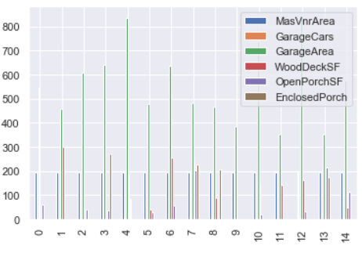
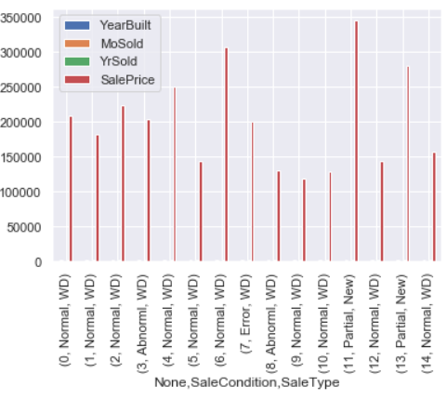
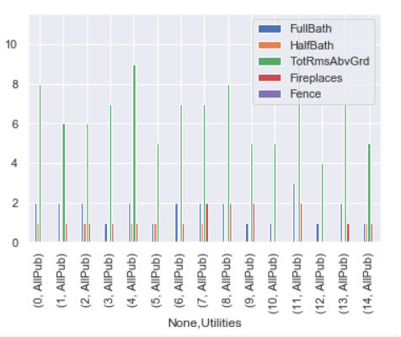
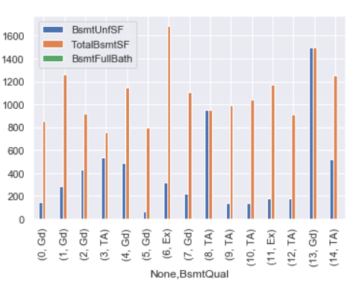

Slide 12
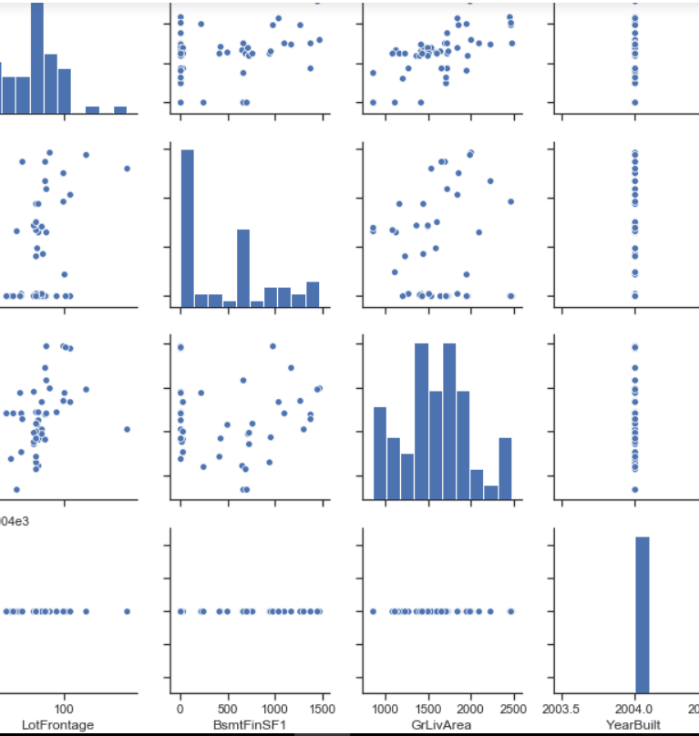
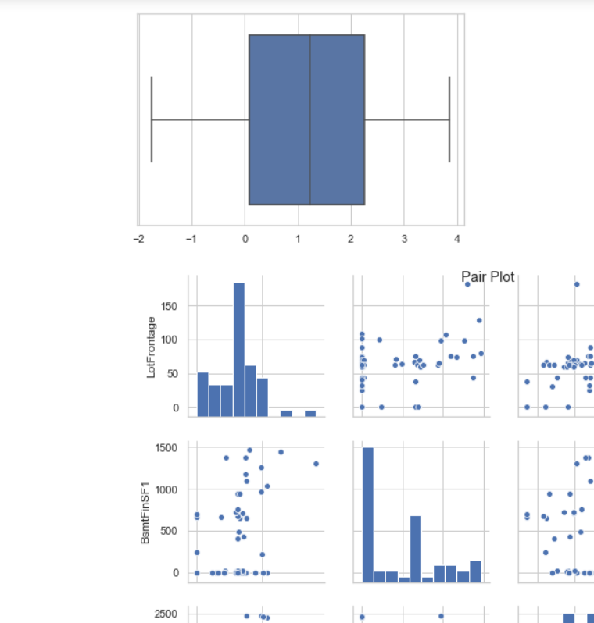

Slide 13
Plotting:
Sales Price VS Quality of the house:
Outliers for quality of house =10 & 9 with price > 700000.
Maximum of houses are whose quality is 8 have been ranged from 15000 to 45000.
Year Sold VS Sales Price
More price for newly constructed houses with all public utilities and overall condition ranging from 7 to 10.
Year sold VS Condition
Average condition of 5 for houses sold in 2008 are at good condition.
3D scatterplot to view actual data points without interpolation for 3 variables: Building type, Sale Type and Sale Condition.

Slide 14
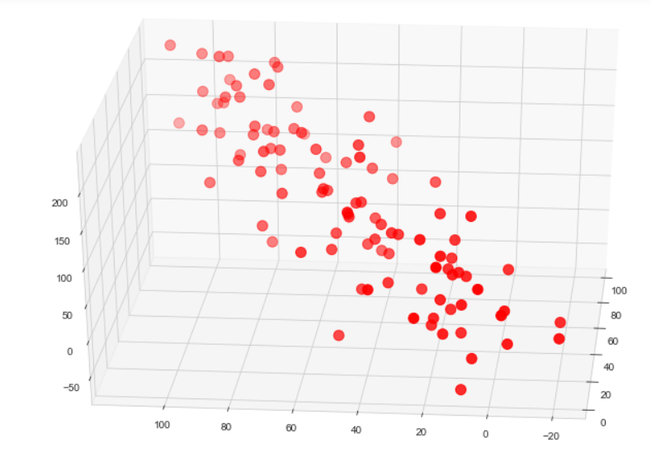
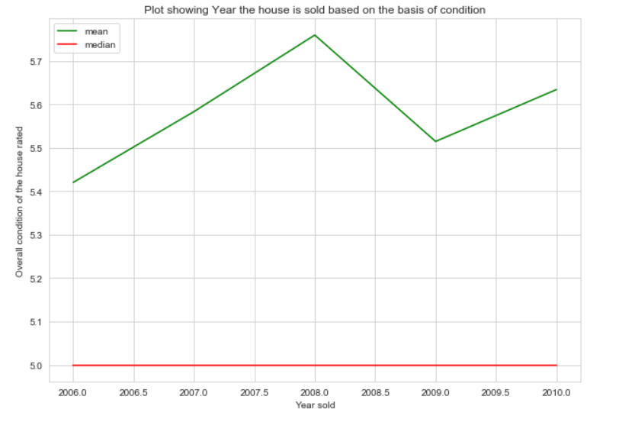
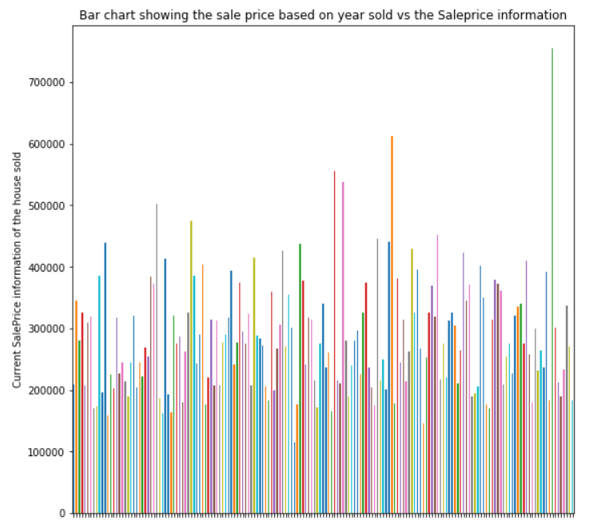
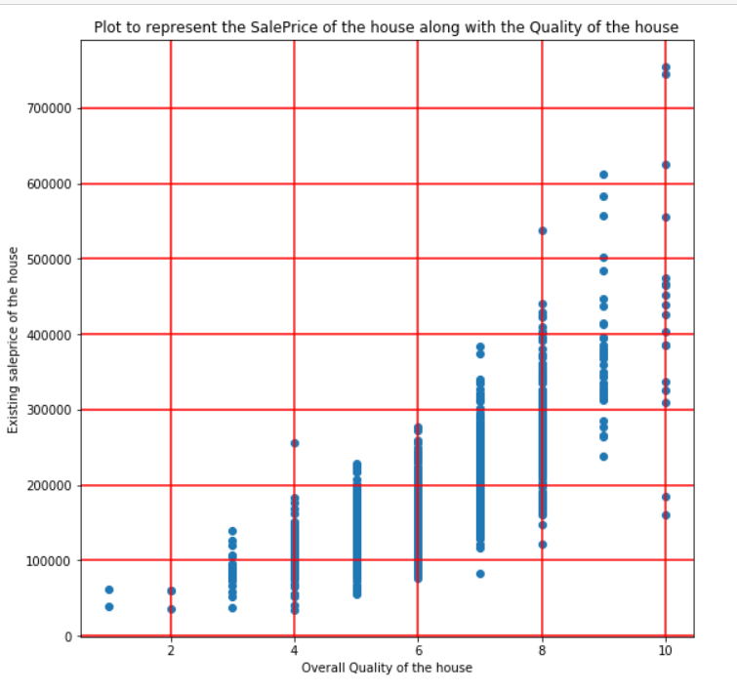

Slide 15
Model, Predict and Solve: Linear Regression LASSO
Calculation of correlation measures. : Positive and Negative Correlation
Visualize features with respect to Sales price. : Scatter Matrix
Compute price per square foot and correlate it. : Computation per square foot
Map them across correlation matrix. : For better visualization of each feature to Sales Price, Heat Map
Feature identification using AVOVA test for disparity score calculation. : 34 Numeric and 35 Categorical features in test dataset. : Categorical values like Neighborhood, ExterQual, KitchenQual play a major role
Identify the most contributing features: Top 10 features
Probabilistic analysis of data: Normalization, RMSE(Root Mean Square Error), probabilistic distribution. : Sample Analysis, LogSalePrice, Quality pivot table
Concatenation of training and test data. : Drop features which are not present in both.
Follow the workflow model to clean and feed the test dataset to the trained model to predict the Sales Price of the houses in the test dataset. : Linear regression model LASSO, Automatic feature selection, Prediction and variance

Slide 16
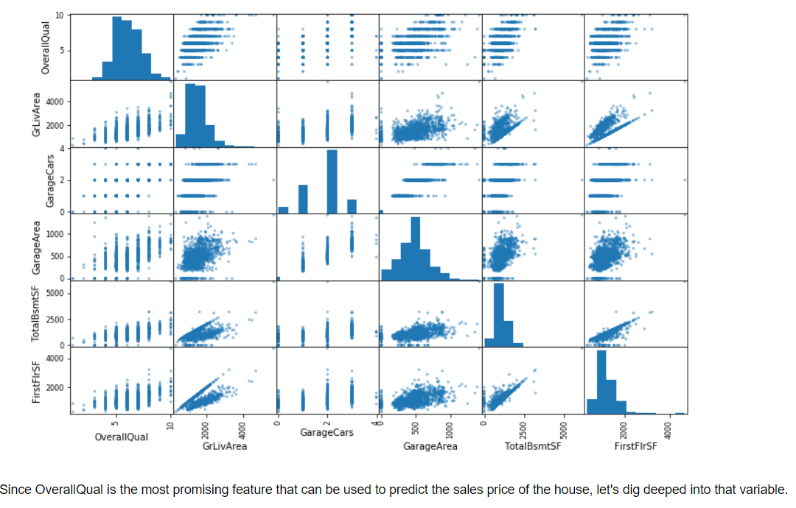
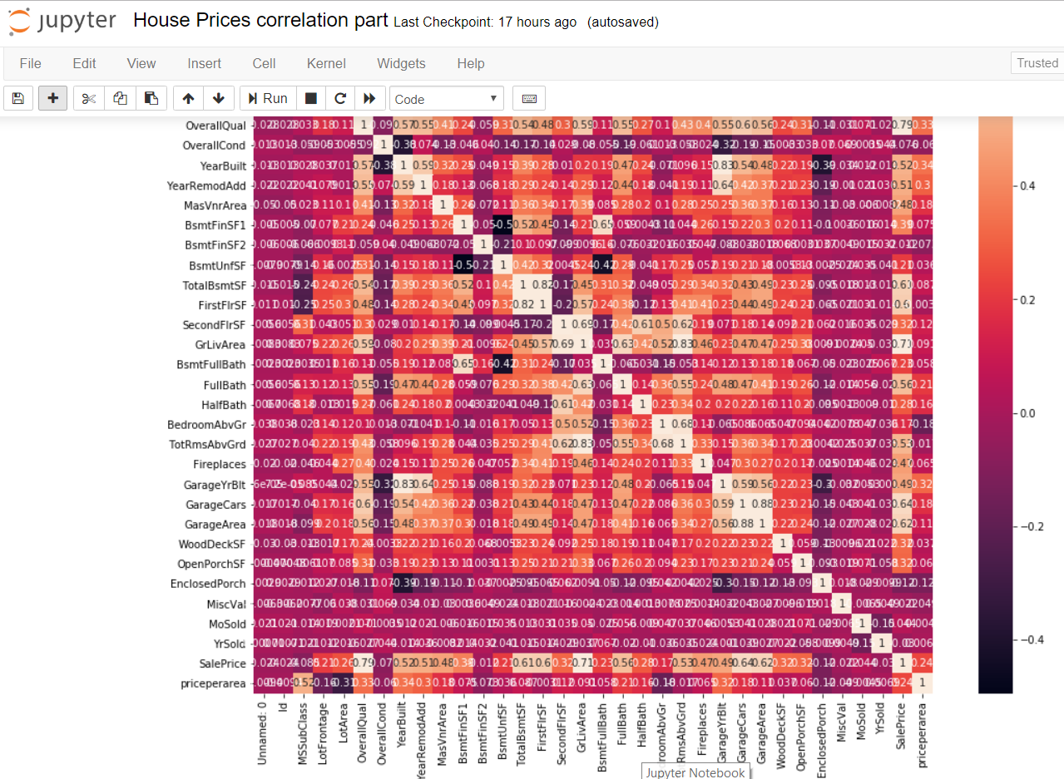
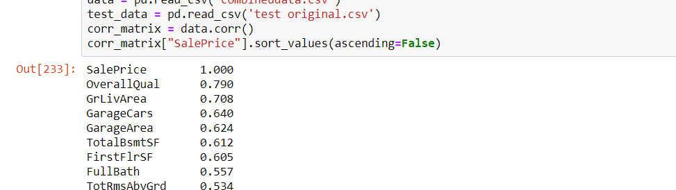

Slide 17
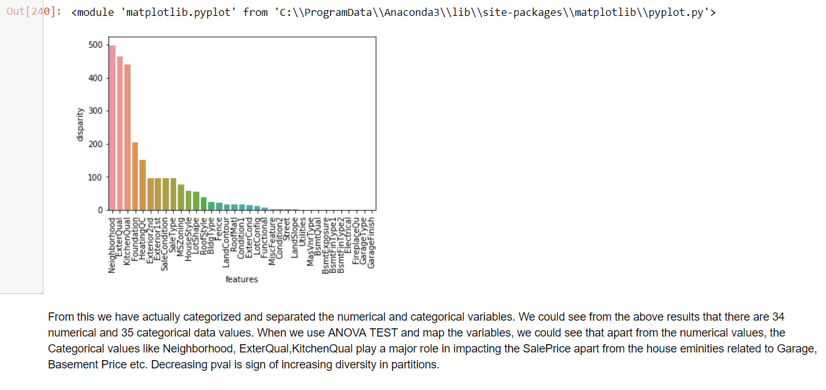
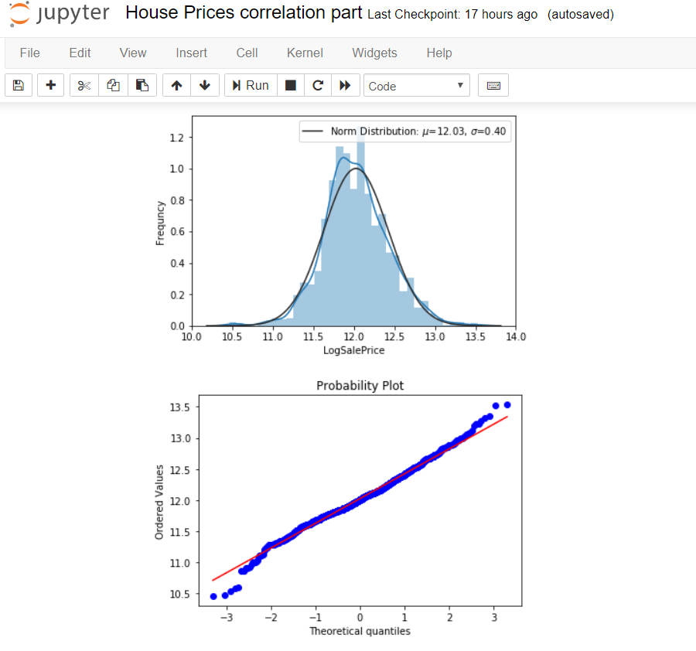

Slide 18
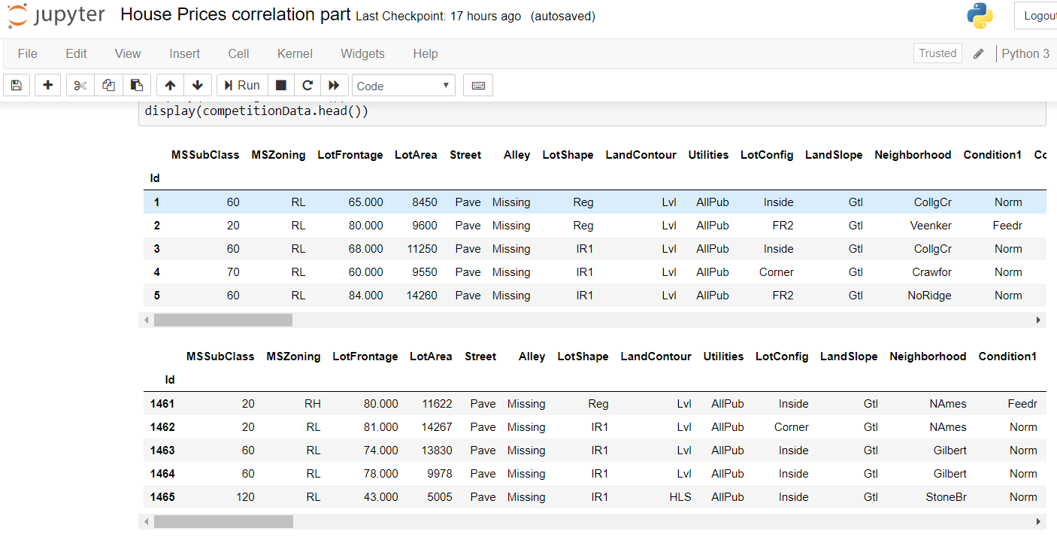
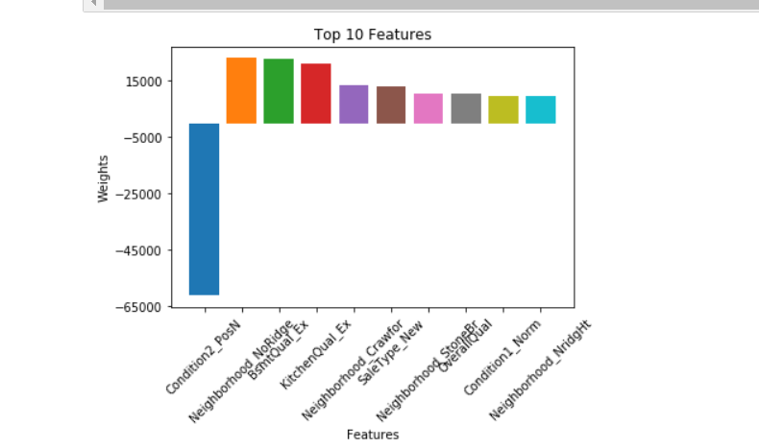
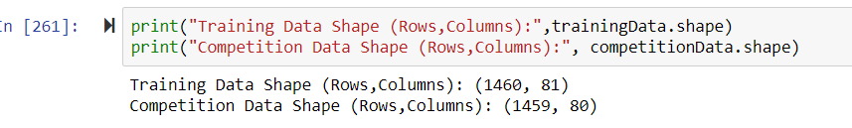

Slide 19
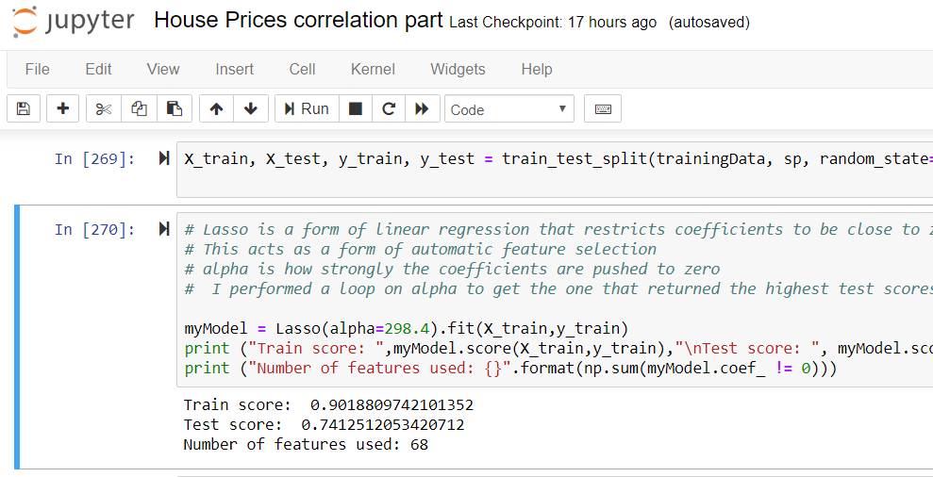
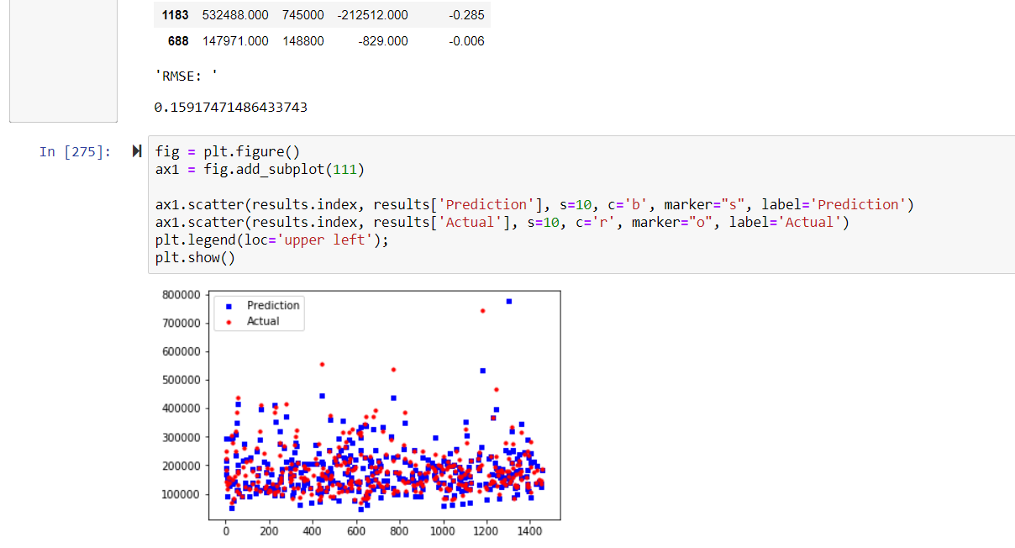
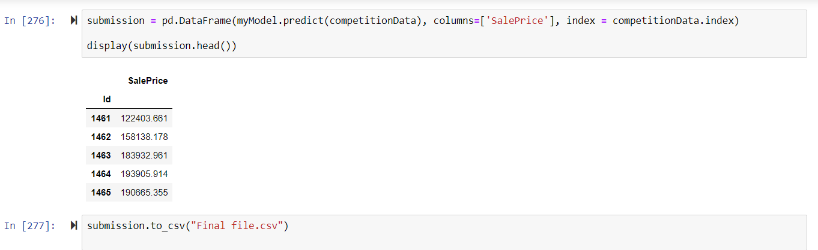

Slide 20
Solution analysis and conclusion:
The sales price of test data set has been predicted using linear regression.
Measures are evaluated as follows:
Skew of training dataset for actual SalePrice= 1.8821982659795333 Kurt of training dataset actual SalePrice = 6.559249935829586
Skew of test dataset for predicted SalePrice = 1.2247085923394503 Kurt of training dataset predicted SalePrice = 2.534267809400883
Since our values for skew and kurt are moving towards their normal distribution value of 0, the predicted saleprice value of the test data is accurate.

Slide 21
THANK YOU

